Slide 1

CS-M151B
Computer Systems Architecture
Blaise Tine
UCLA Computer Science

Slide 2

Attendance

Slide 3
Agenda
Control Hazards
Midterm Review

Slide 4
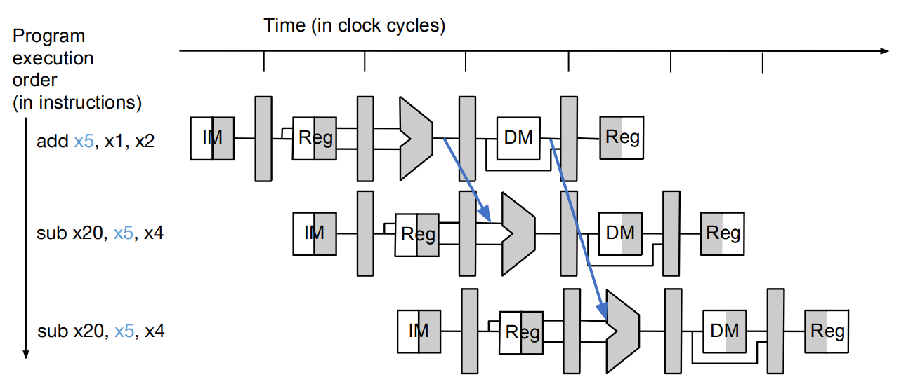
Recap of Data Forwarding
Data forwarding: ALU to ALU
Forwarding from EX/MEM pipeline latch
Forwarding from MEM/WB pipeline latch

Slide 5
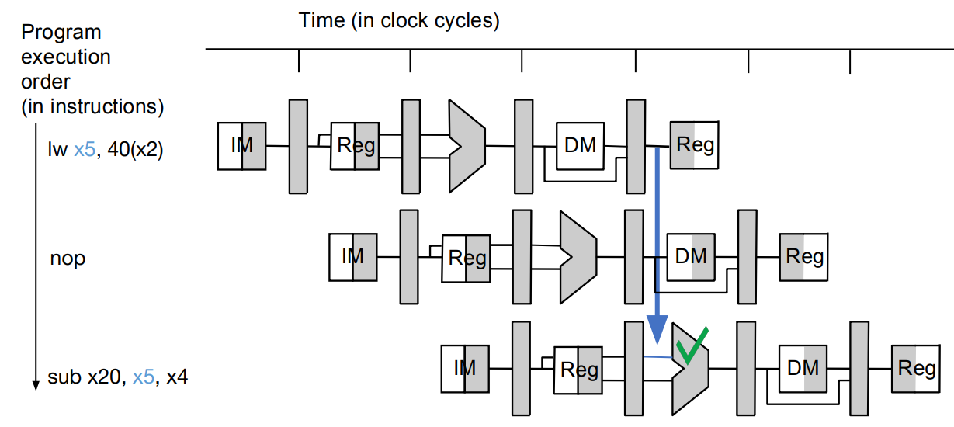
Recap of Data Forwarding
Data forwarding: Memory-ALU
Add one bubble/NOP
Then forwarding from MEM/WB pipeline latch

Slide 6
Control Hazards
Understanding branches
e.g. for loop
main: li t0, 0 # i = 0 li t1, 10 # n=10
loop:
addi t0, t0, 1 # i = i + 1 bne t0, t1, loop # if (i != n) => loop
exit: li a0, 0 # return 0 ret
int main() { for (int i = 0; i < 10; i++) { // loop body } return 0; }

Slide 7
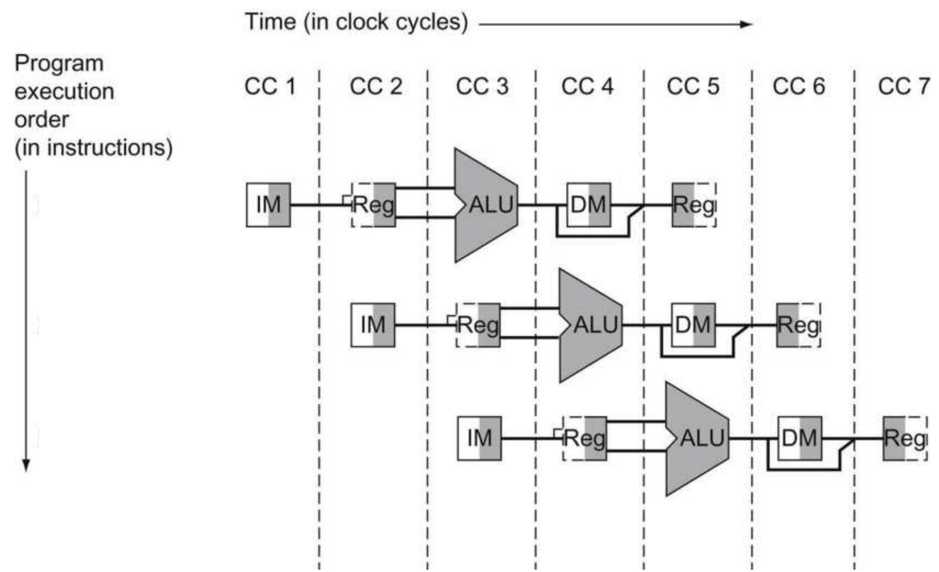
Control Hazards
Data and control dependence
I0: addi x5, x5, 1
I1: bne x5, x6, loop
Whether to branch?
(x5 == x6)
Where to branch?
PC + imm
I0 I1

Slide 8
Control Hazards
RISC-V branches
Conditional branches
BEQ r1, r2, imm; // if (r1 == r2) => PC = PC + imm
Unconditional branches
JAL rd, imm; // rd = PC + 4; PC = PC + imm
JALR rd, rb, imm; // rd = PC + 4; PC = rb + imm

Slide 9
Control Hazards
CPU must answer 3 questions:
Which type of branch?
Whether to branch?
Where to branch?

Slide 10
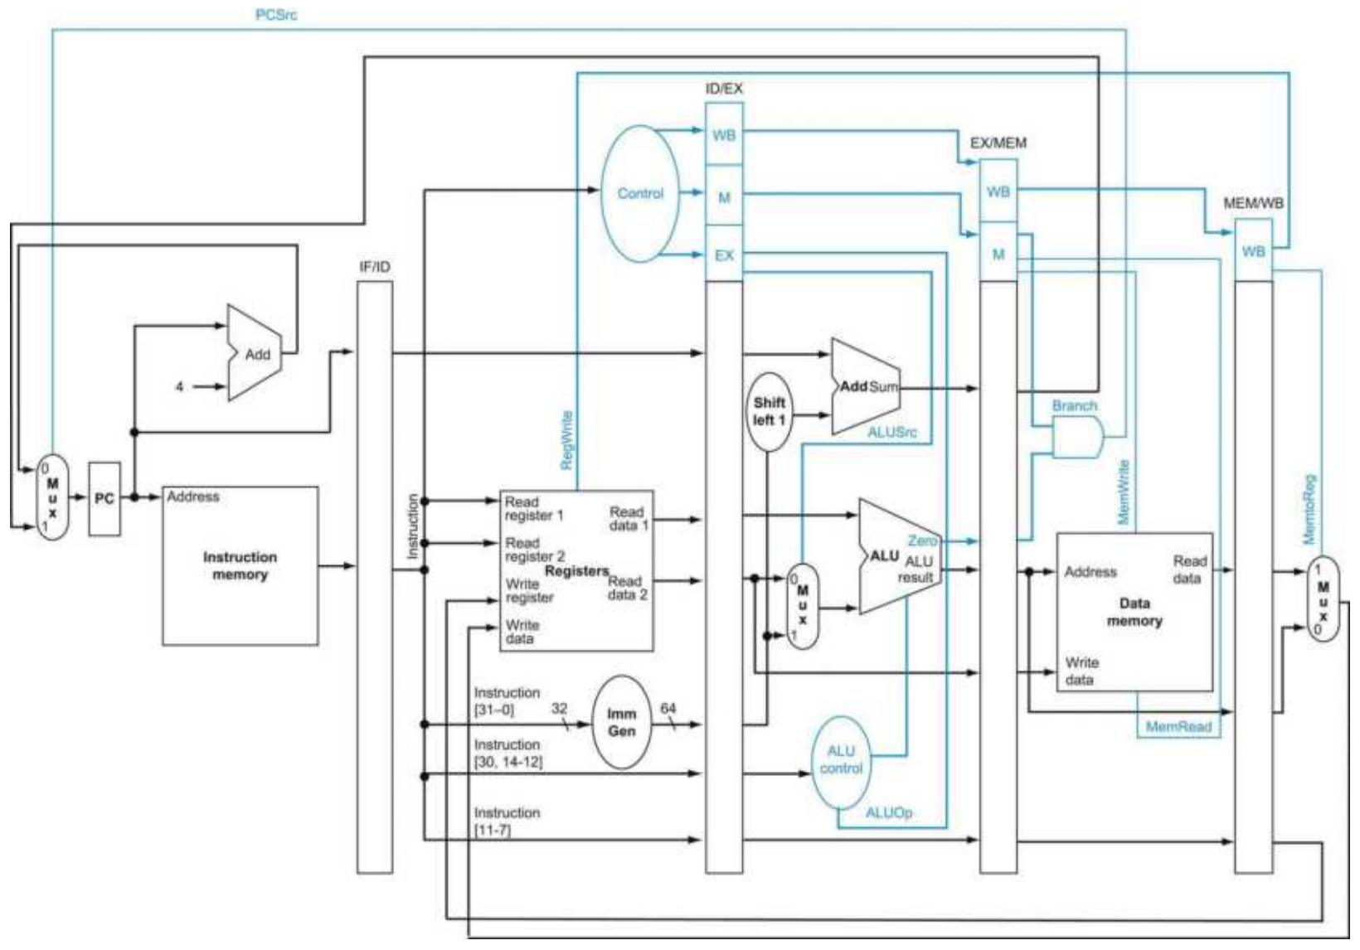
Control Hazards
Which type of branch
Where to determine this?
ID stage

Slide 11
Control Hazards
Whether to branch
Where to determine this?
MEM stage (PCSrc)

Slide 12
Control Hazards
Where to branch
Where to determine this?
EX stage

Slide 13
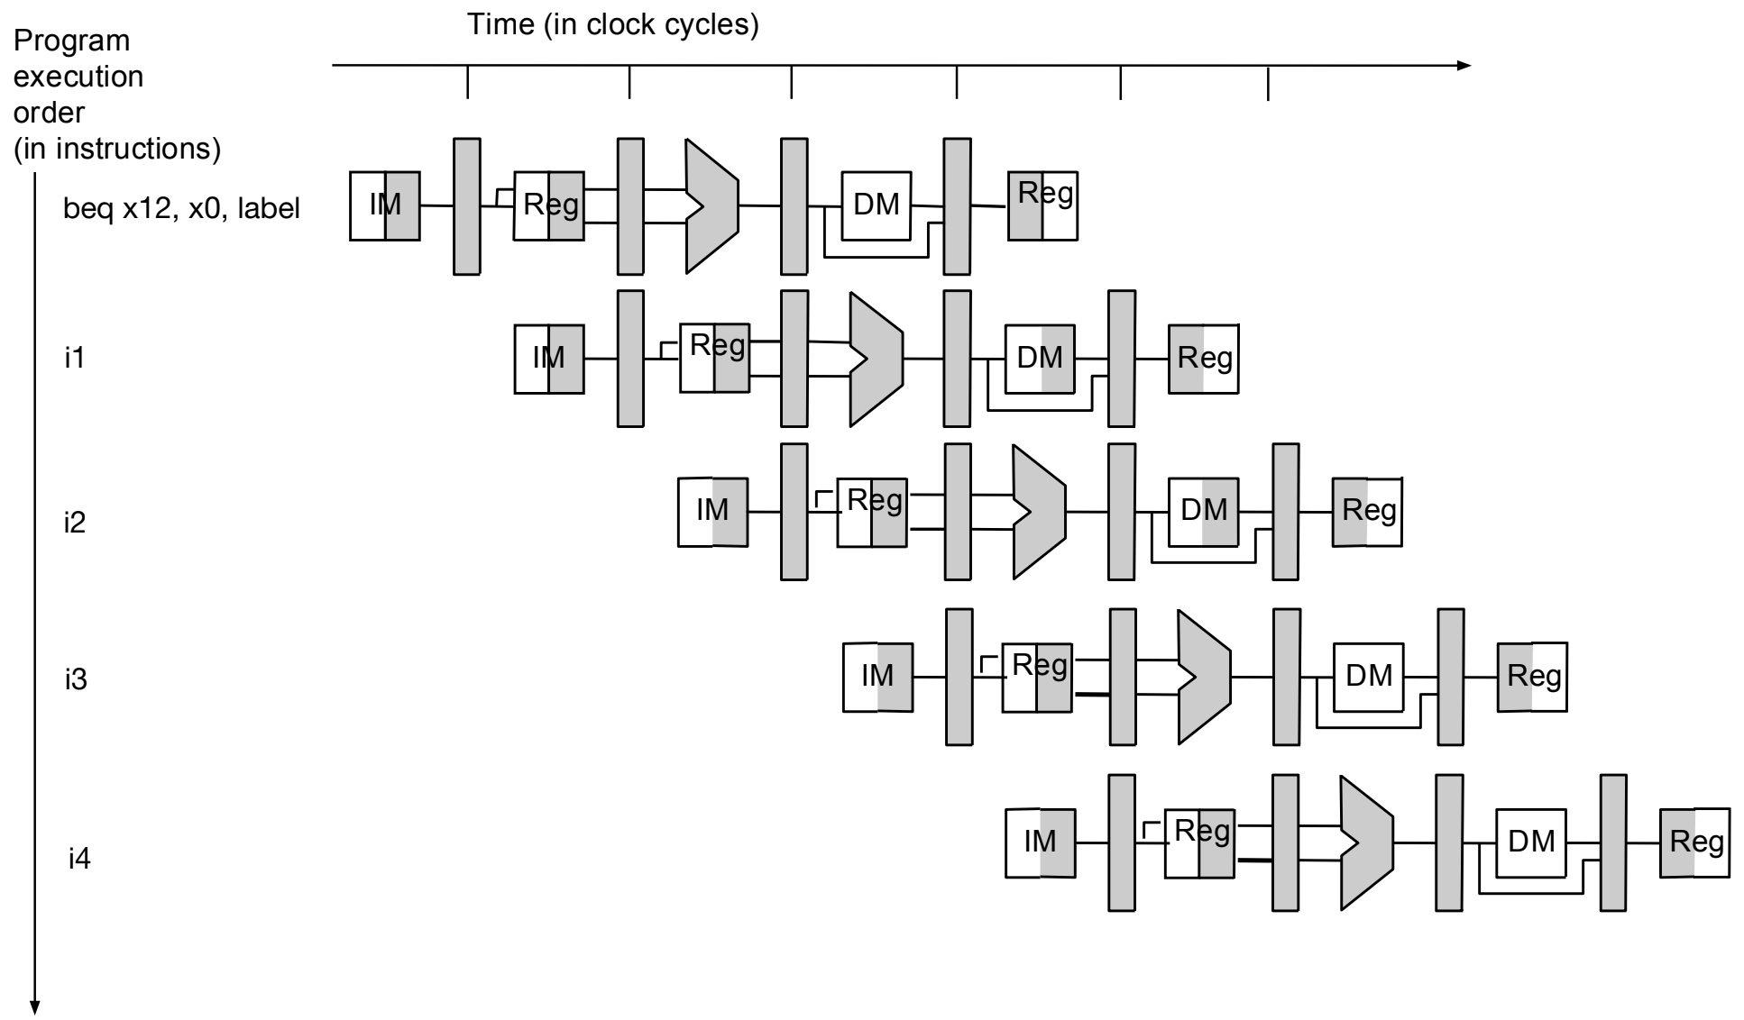
Control Hazards
Which stage should stall?
ID stage
Why?
Next PC

Slide 14
Control Hazards
When is new PC updated?
Next cycle after PCSrc

Slide 15
Control Hazards
When is new PC updated?
PCSrc is ready in MEM
New PC is ready in WB

Slide 16
Control Hazards
Stall cycles needed?
3 cycles
Can we do better?

Slide 17
Control Hazards Handling
Software Solution: Insert NOPs
S/W insert NOPs in delay slots
Pros:
No H/W cost
Cons:
Bad performance: still stalling
S/W depends on H/W stall count

Slide 18
Control Hazards Handling
Software Solution: Delayed branch
S/W insert useful instructions in delay slots
Pros:
No H/W cost
Improved performance
Cons:
Hard to find useful instructions
S/W depends on H/W stall count

Slide 19
Control Hazards Handling
Hardware Solution: Stall the pipeline
Pros:
S/W independence
Minimal H/W cost
Cons:
Bad performance

Slide 20
Control Hazards Handling
Hardware Solution: Speculation
Pros:
S/W independence
Better performance
Cons:
H/W cost

Slide 21
Control Hazards: Speculation
Predict: Not taken
Emulate delay branch
Pros: no wasted cycles
Cons: mis-prediction cost

Slide 22
Control Hazards: Speculation
Predict: Not taken
How to detect misprediction?
Branch condition is taken
When?
MEM stage

Slide 23
Control Hazards: Speculation
Predict: Not taken
How to recover from misprediction?
Flush the pipeline (invalidate each previous stage)
Reset PC

Slide 24
Control Hazards: Speculation
Practical Branch stats
About 20% of instructions is control-flow
50% of forward branches (if-then-else) are taken
90% of backward branches (loops) are taken
30% of all branches are not-taken

Slide 25
Control Hazards: Speculation
Practical Branch stats
About 20% of instructions is control-flow
50% of forward branches (if-then-else) are taken
90% of backward branches (loops) are taken
30% of all branches are not-taken
Not-taken prediction accuracy?
Only 30%
Cost: 3 cycles

Slide 26
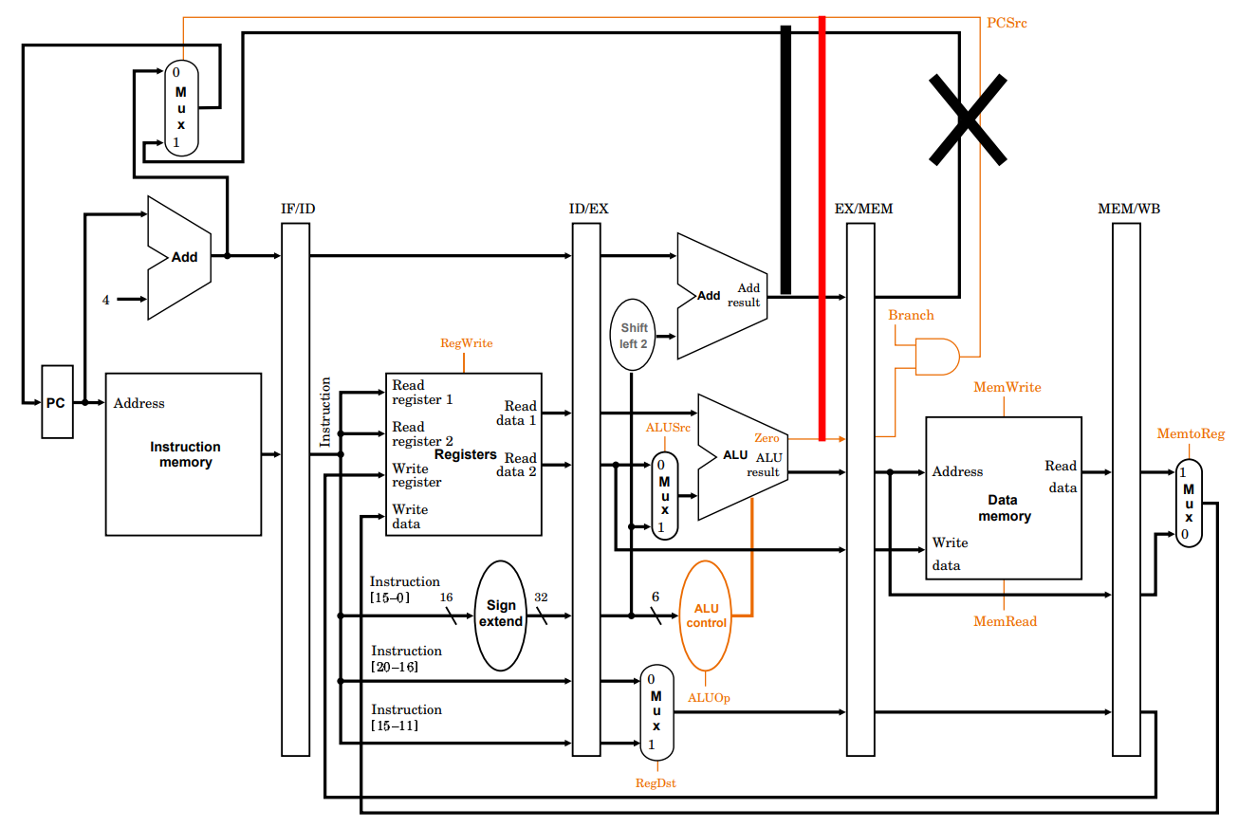
Control Hazards: Speculation
Reducing Misprediction Cost
Resolving branches sooner
Making it 2 cycles can be done

Slide 27
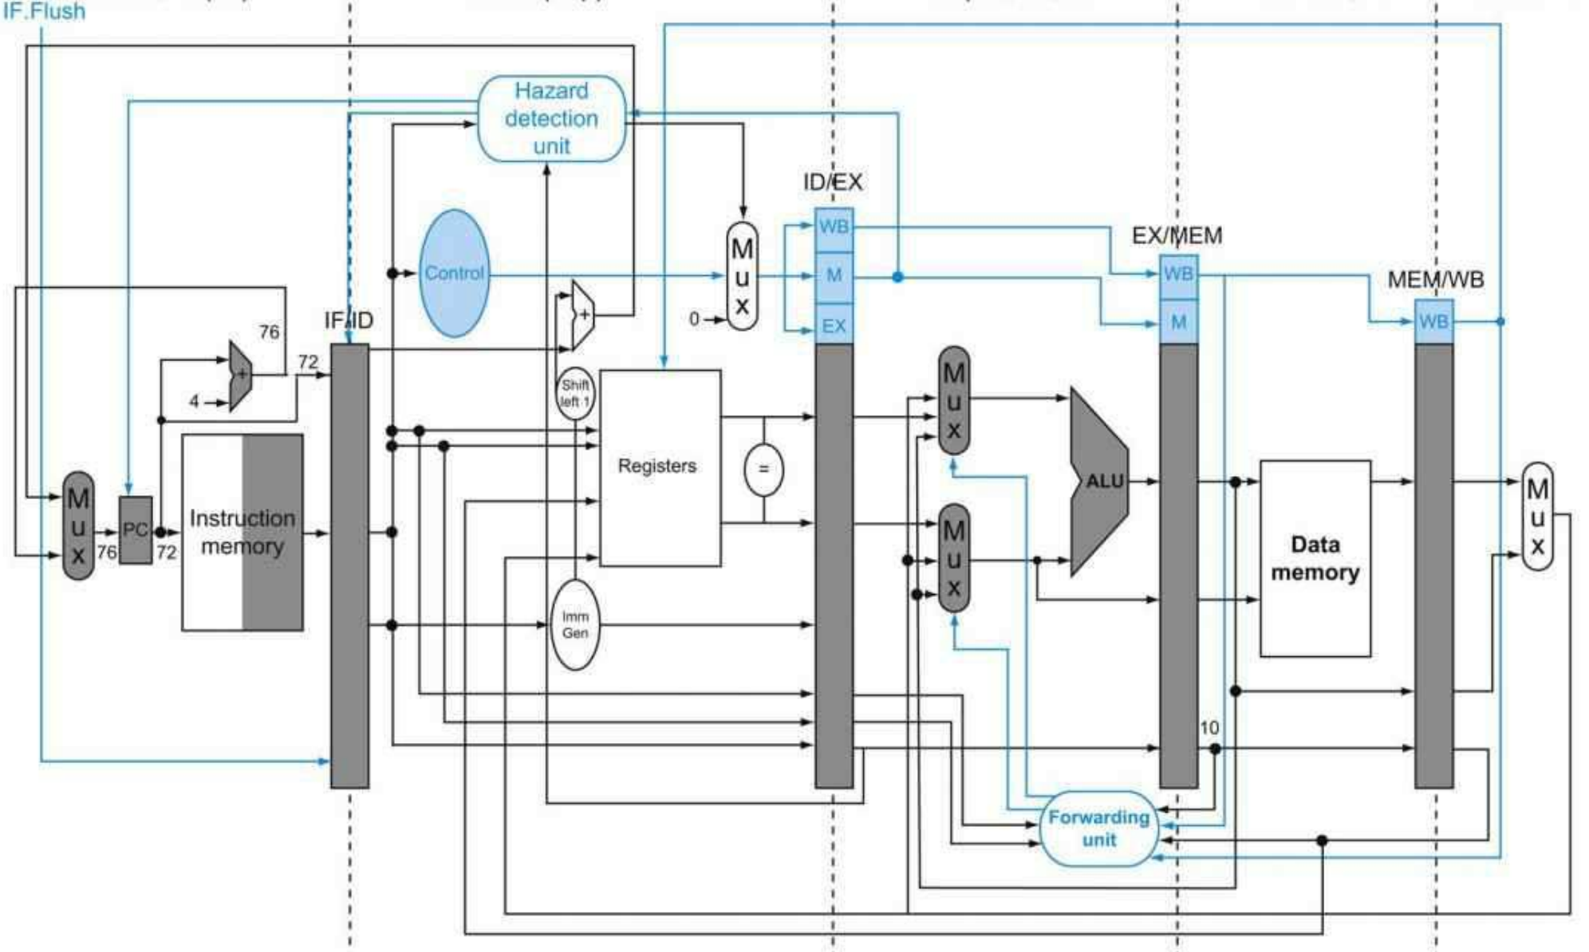
Control Hazards: Speculation
Reducing Misprediction Cost
More aggressive solution: Branch only
Move NextPC to DE
Move PC + imm to DE
Warning: r1/r2 RAW
Need data forwarding!

Slide 28
Control Hazards: Speculation
Predict: Always Taken
What do we need?
nextPC
At fetch stage

Slide 29
Control Hazards: Speculation
Predict: Always Taken
How to obtain nextPC?
We can predict

Slide 30
Control Hazards: Speculation
Predict: Always Taken
How to obtain nextPC?
We can predict

Slide 31
Midterm Review
performance/cost tradeoffs between single-cycle, multi-cycle, pipeline architecture.
memory alignment, motivation, hardware and software workarounds
RISC-V vs CISC vs VLIW
CPU time, CPI, cycle time, clock rate, clock frequency
the memory wall problem
what the memory address is, what the address bus is, what the data bus is, what the control bus is?
what is included and not included in the ISA, and why?
Addressing modes; should be able to compare two (pros/cons) given the description of how they work
How RISC-V immediate is encoded, e.g JAL format is [imm[20], imm[10:1], imm[11], imm[19:12], rd, opcode]
How to encode a RISCV instruction into binary
Given a RISCV assembly code to read and determine the final result
Understand the number of pipeline stalls due to RAW dependencies when we have pipeline latches versus pipeline registers
understanding data forwarding, how to detect it, also which RAW case data forwarding doesn't handle

Slide 33
Acknowledgement
This course is partly inspired and use materials from the following courses created by my colleagues:
ECE-M1126C: Nader Sehatbakhsh @ UCLA
CS3220: Hyesoon Kim @ gatech

